Slide 1
Products for Southern Africa from the MOGREPS Ensemble System
Chris Tubbs, Guidance Unit, UK Met Office
27th October 2016

Slide 2
1. Met Office ensemble models named MOGREPS, stands for Met Office Global and Regional Ensemble Prediction System

Slide 3
Structure of this talk
Introduction to ensembles and quantifying uncertainty
Current MOGREPS products available on the SWFDP website
Potential future products from MOGREPS (available in the UK)
Questions

Slide 4
Ensemble modelling capability
MOGREPS-G
33km 70 Levels
3 day forecast 4 times/day
12 members
7 day
MOGREPS-UK
2.2km 70 Levels
36 hour forecast 4 times/day
12 members

Slide 5
Ensembles
Deterministic Forecast
Initial Condition Uncertainty
X
Analysis
Climatology
time
Forecast uncertainty
Notes:
Animation in this slide can help illustrate the ensemble concept. Time runs from left to right so we are forecasting from the analysis to some point in the future which must lie within the climatology. There is a region of uncertainty in the forecast but we do not know what it is. The standard deterministic forecast just gives a point within this region. However we know there is uncertainty in the analysis (click to introduce). By randomly sampling within this uncertainty we can produce a set of forecasts (click to animate) which gives us a sampling of the forecast uncertainty on the right – the only estimate we have of what this forecast uncertainty is.

Slide 6
MOGREPS
Met Office Global and Regional Ensemble Prediction System
4 cycles per day | 12 members per cycle
24 member products by lagged averaging of last 2 cycles
Global Component (MOGREPS-G)
33km, 70 Levels (N400 L70)
T+7days (with last 2 runs lagged)
Run at 00Z, 06Z, 12Z and 18Z
ETKF for IC perturbations
Stochastic physics (SKEB2) and random parameters
MOGREPS-UK (as an aside)
2.2km resolution, 12-member ensemble
Run to T+36h 4xdaily at 03 / 09 / 15 / 21Z
Nested in 33km MOGREPS-G
Based on 1.5km UKV deterministic model physics
Notes:
MOGREPS has been operational since Sept 2008 after 3-years of trials

Slide 7
2. General ensemble forecast products

Slide 8
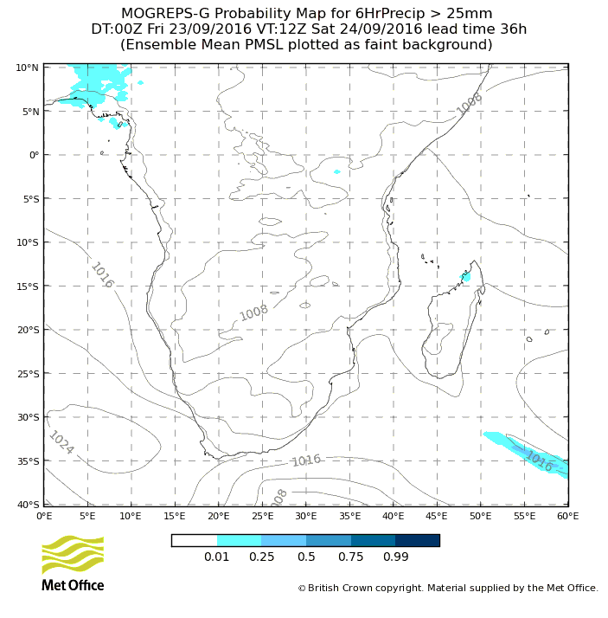
Probabilities 6 Hour Precip > 25 mm
Notes:
>50mm is available
Also >50mm and >100mm in 24 hours are available

Slide 9
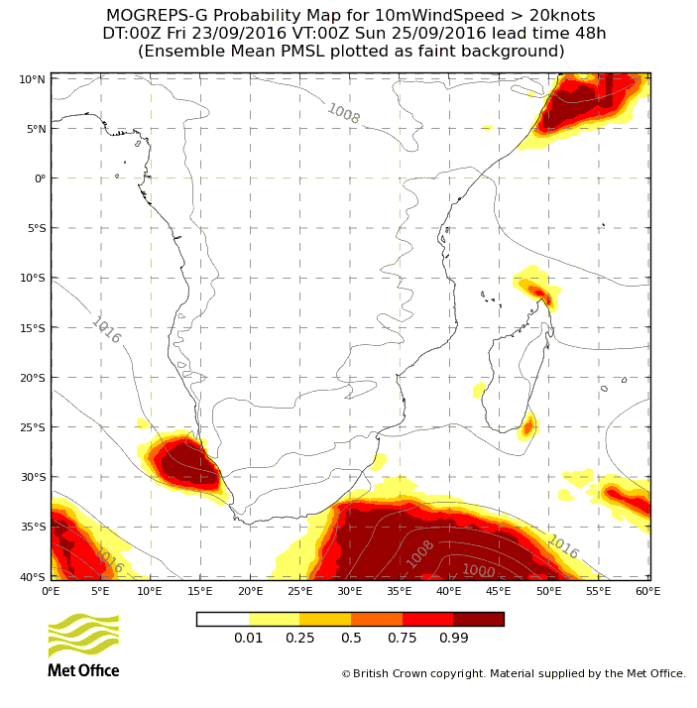
Probability10m Wind Speed > 20 kts
Notes:
> 30 knots is available

Slide 10
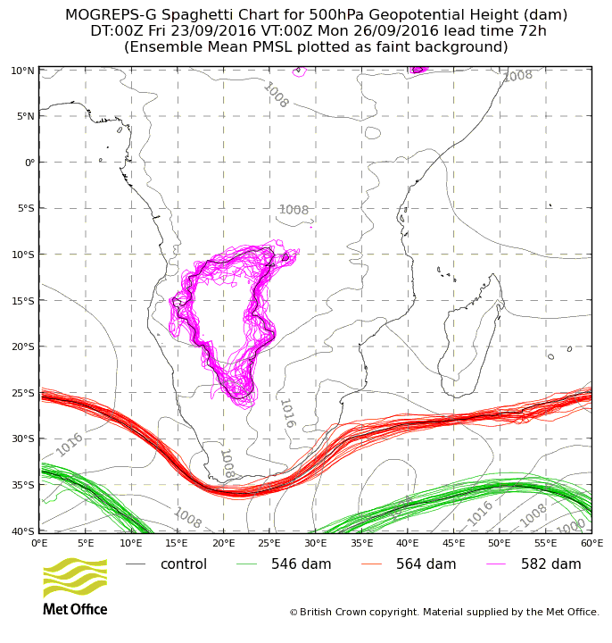
500hPa height spaghetti plot

Slide 11
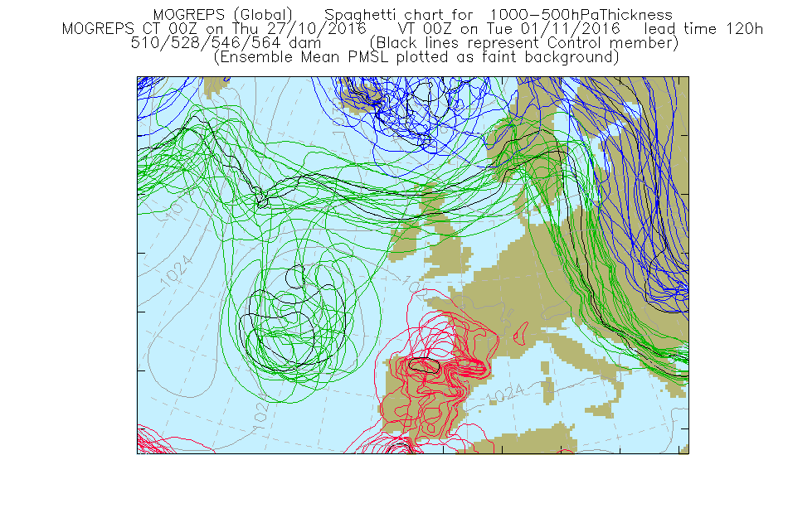

Slide 12
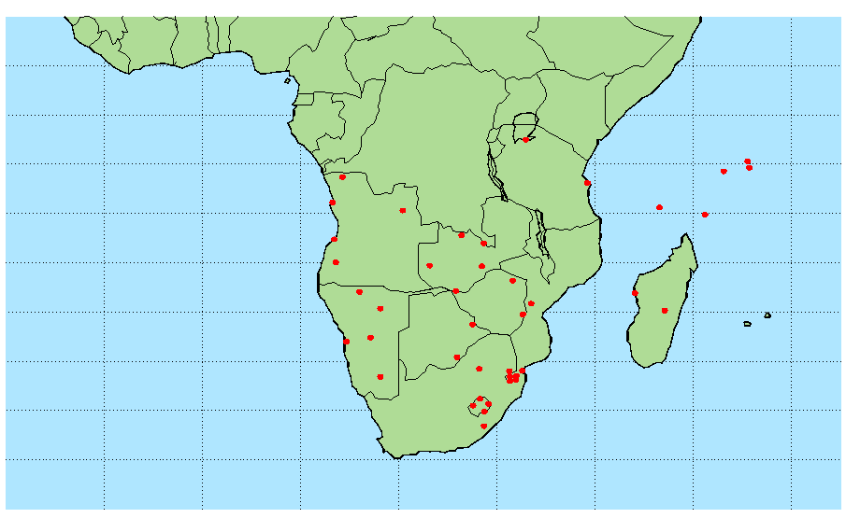
Site Specific Meteogram locations

Slide 13
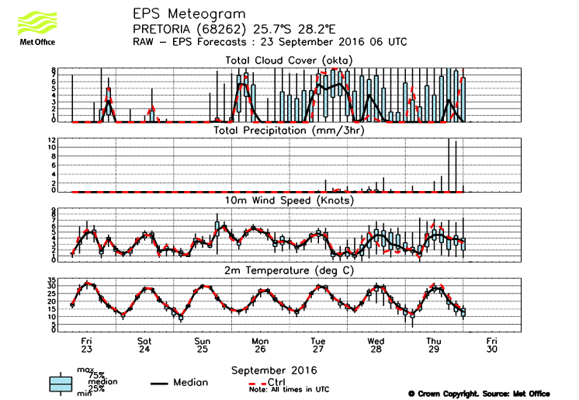
Meteogram for Pretoria

Slide 14
3. Possible future ensemble products (available to UK Meteorologists)

Slide 15
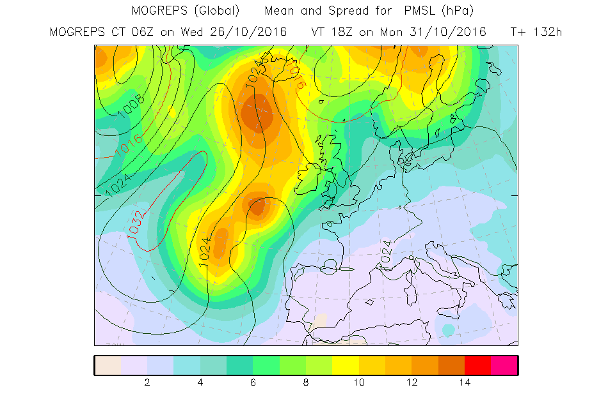

Slide 16
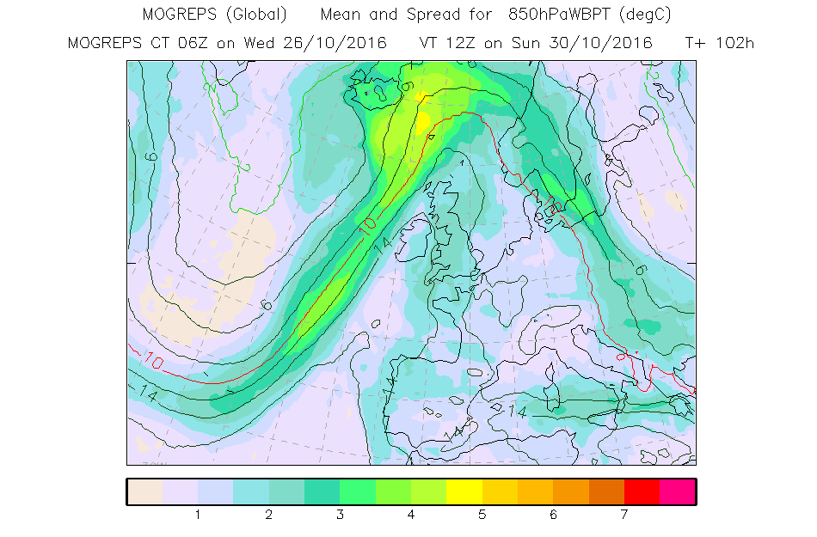

Slide 17
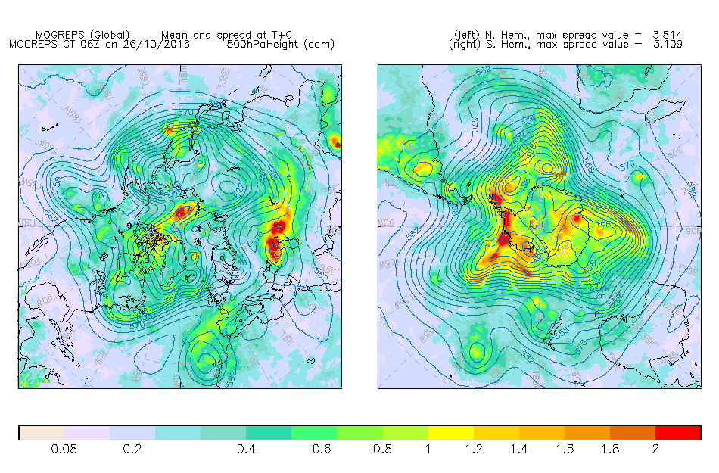

Slide 18
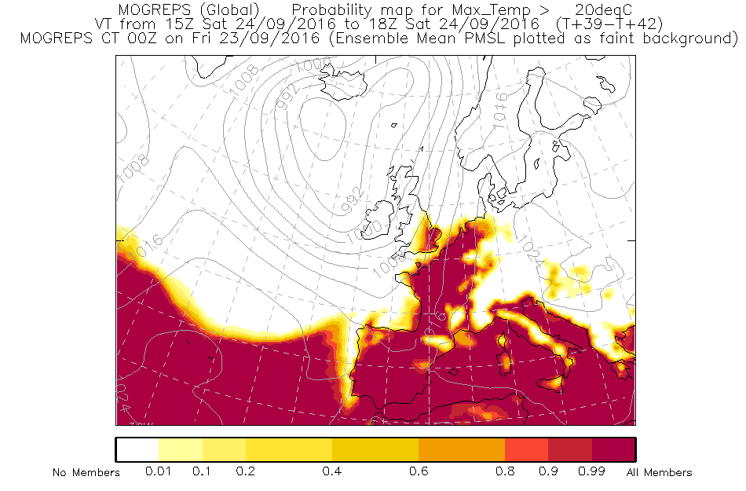
Prob Max temp >20 deg C

Slide 19
Forecast dew points

Slide 20
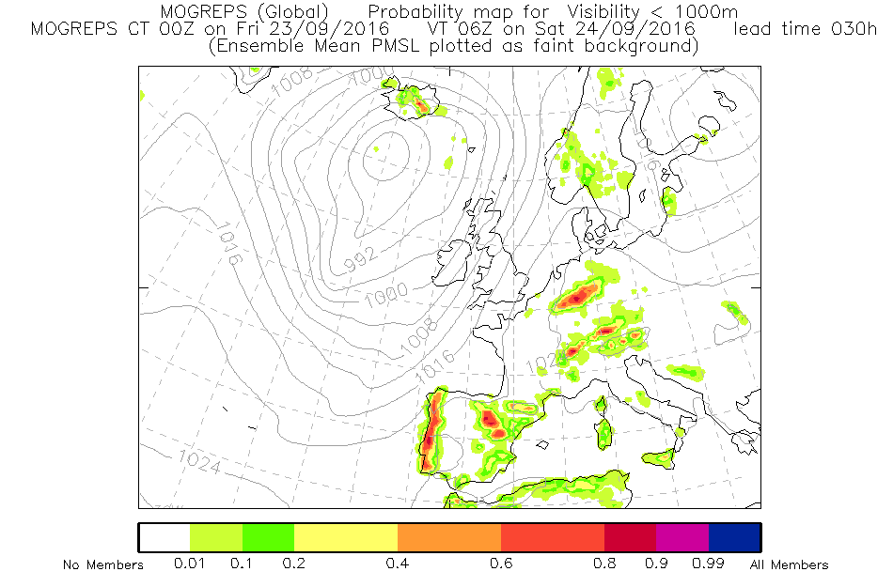
Prob Vis <1000m

Slide 21
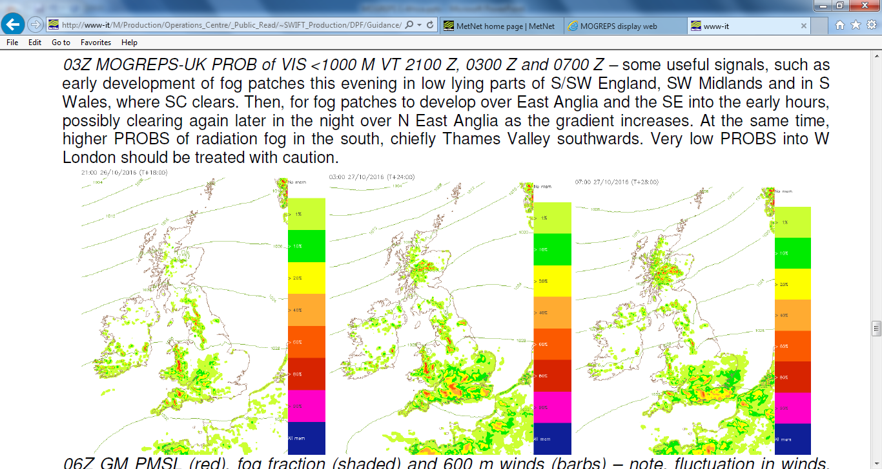

Slide 22
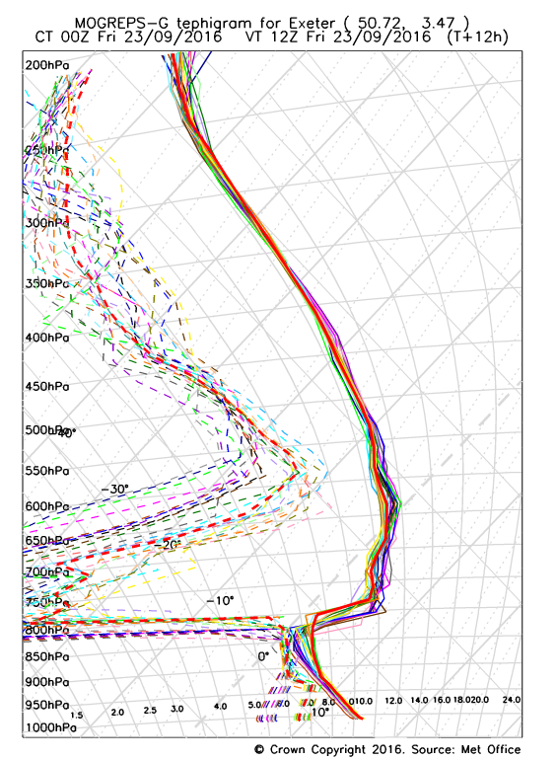
Ensemble forecast tephigram for Exeter, UK

Slide 23
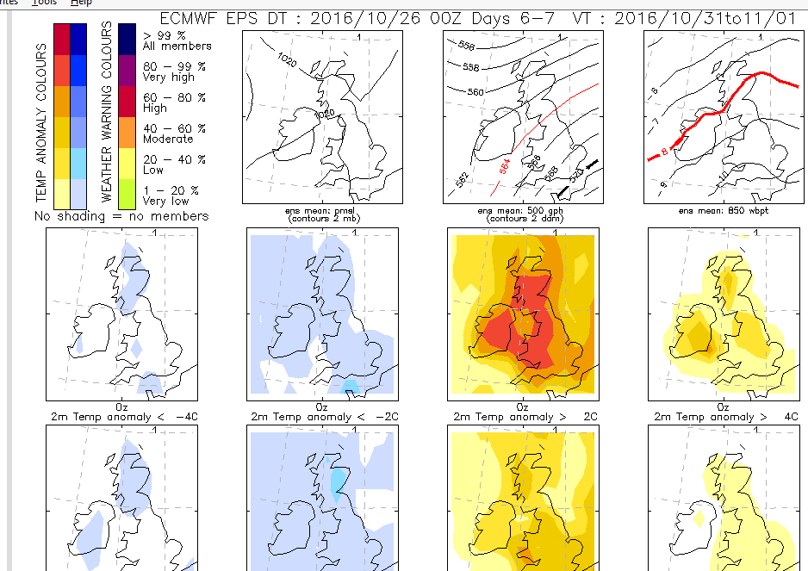

Slide 24
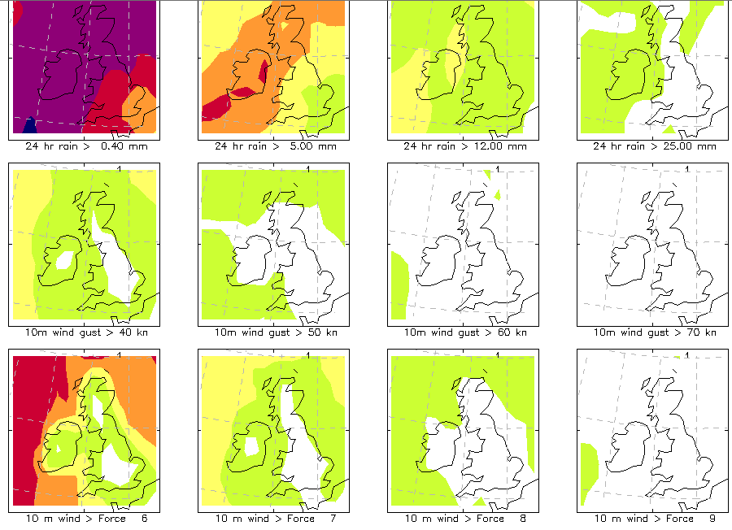

Slide 25
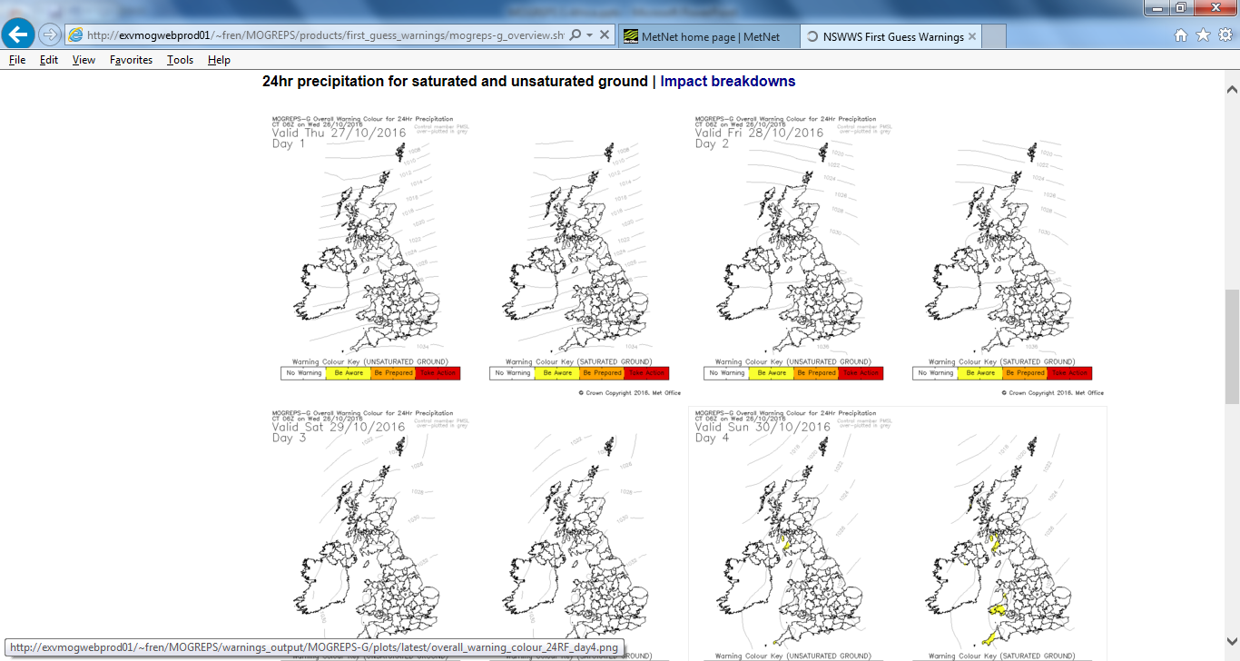

Slide 26
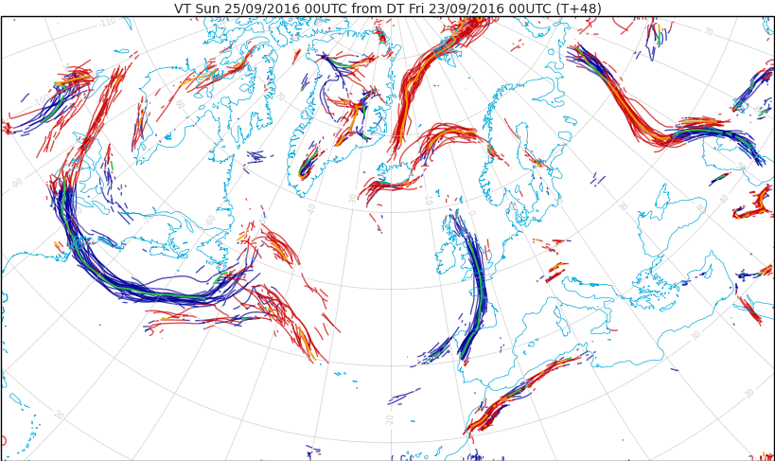
Fronts animation

Slide 27
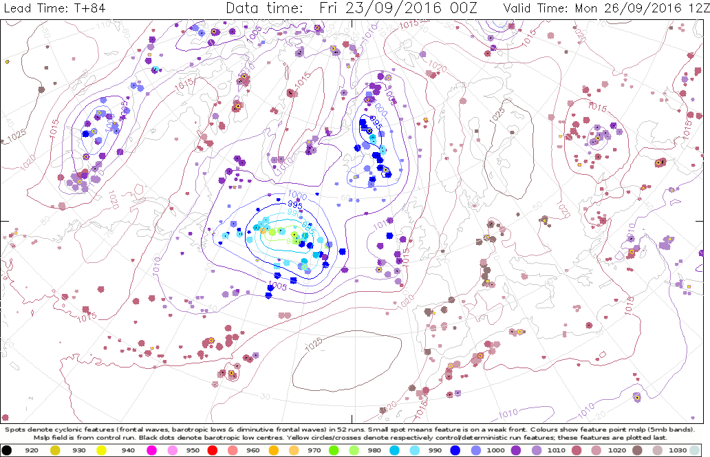
Synoptic features animation

Slide 28
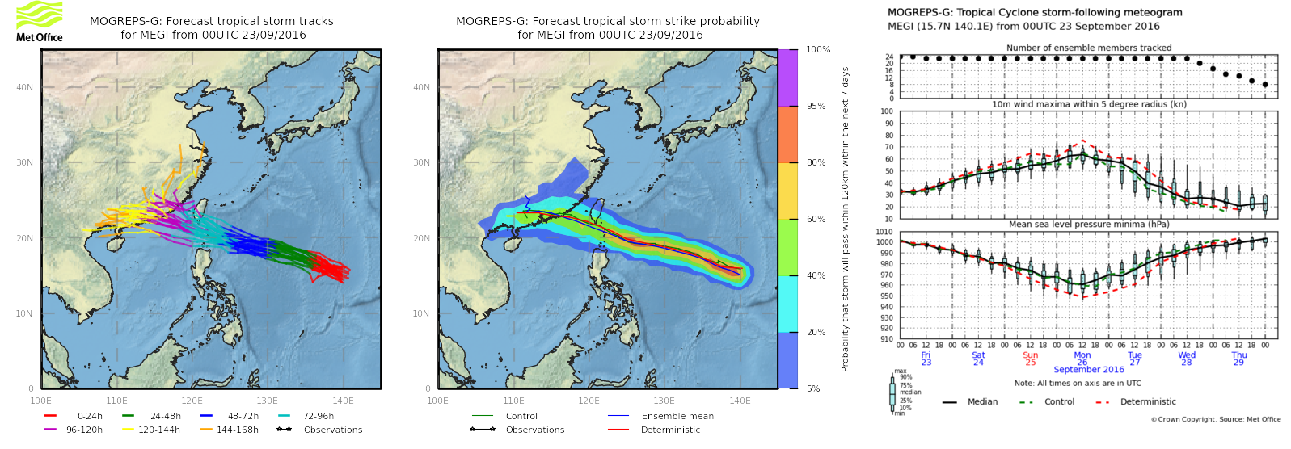
Typhoon Megi track probs

Slide 29
Megi storm following meteogram

Slide 30
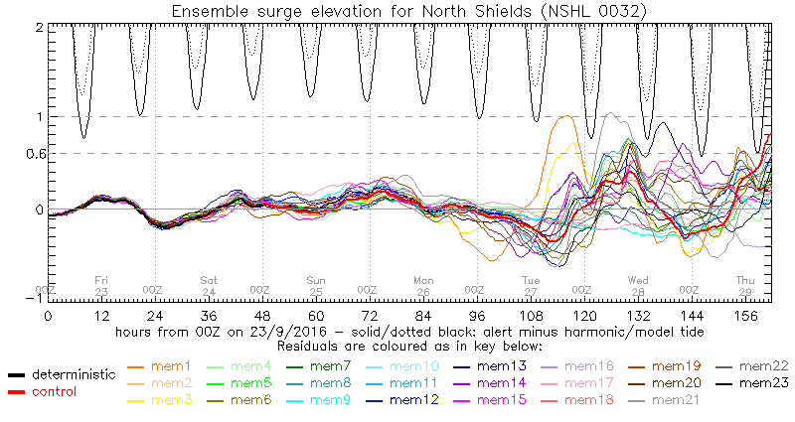
Surge ensemble for N Shields, NE England

Slide 31
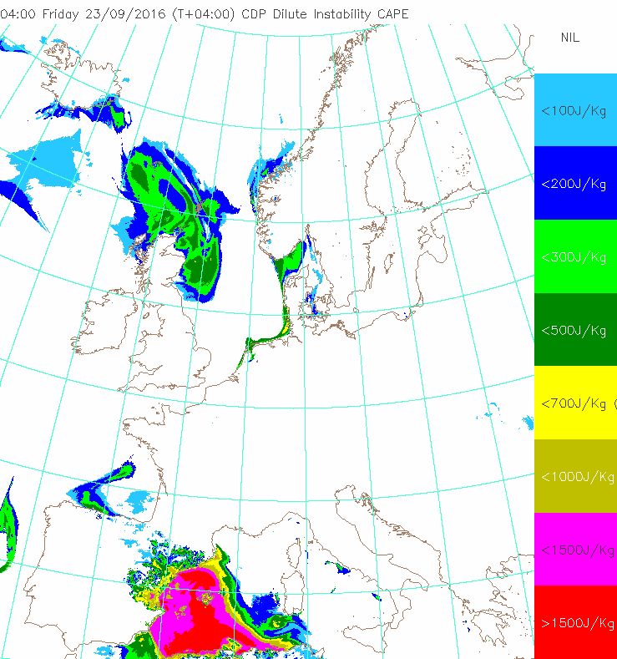
Surface driven CAPE

Slide 32
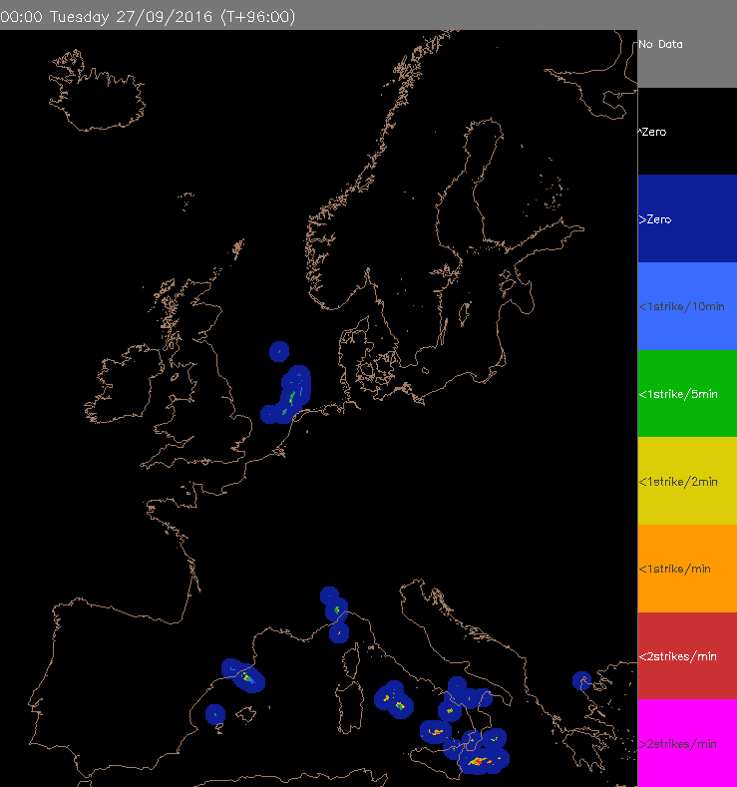
Lightning rate (strikes/min)

Slide 33
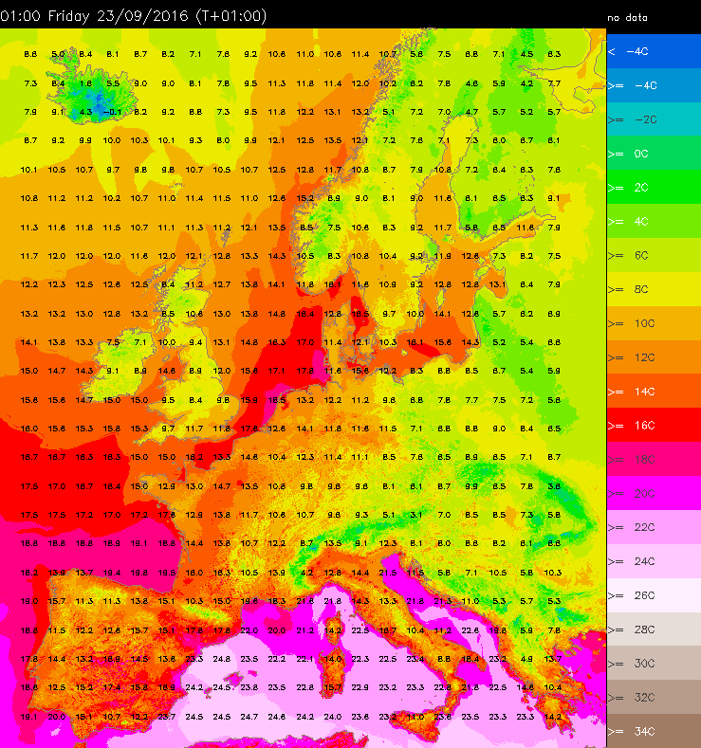
Temperatures

Slide 34
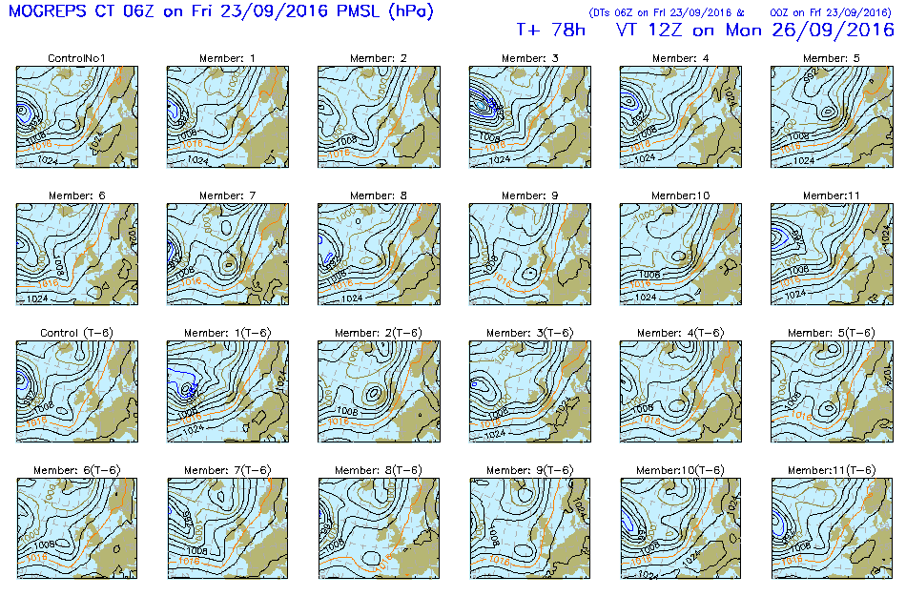
MSLP postage stamps

Slide 35
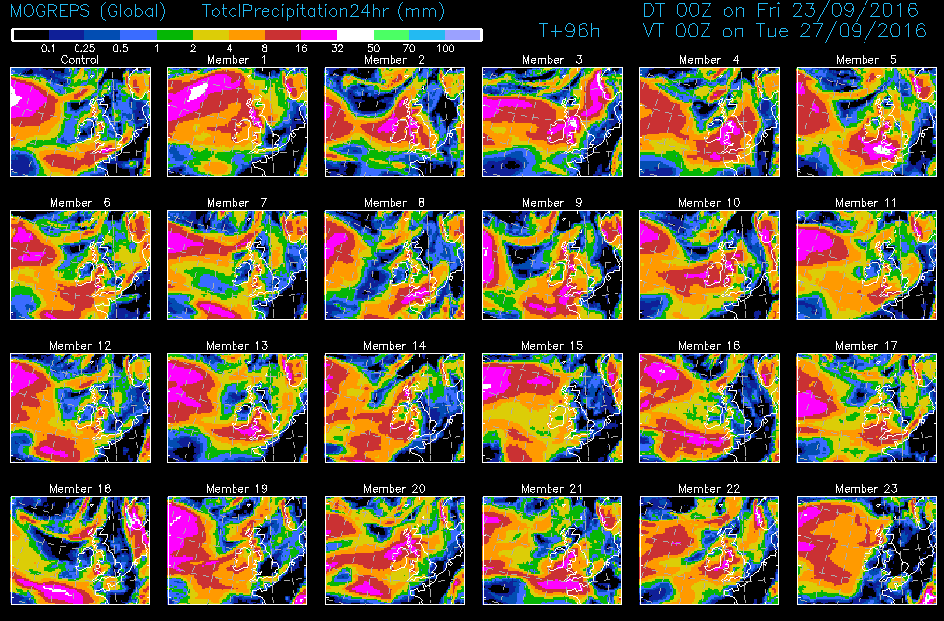
24 hr precip postage stamps

Slide 36
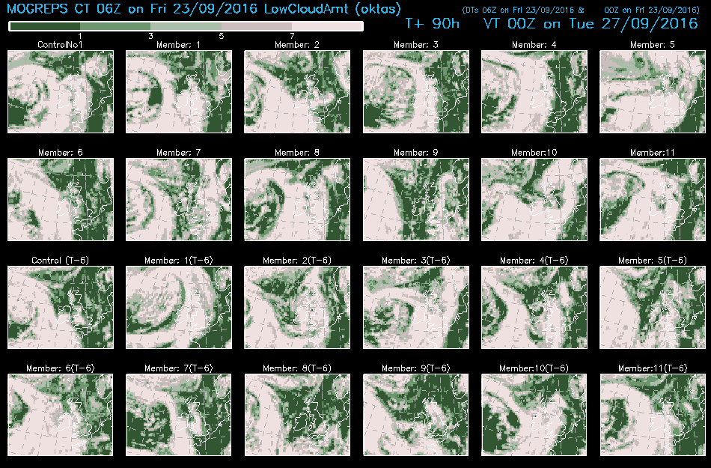
Low cloud amount postage stamps

Slide 37
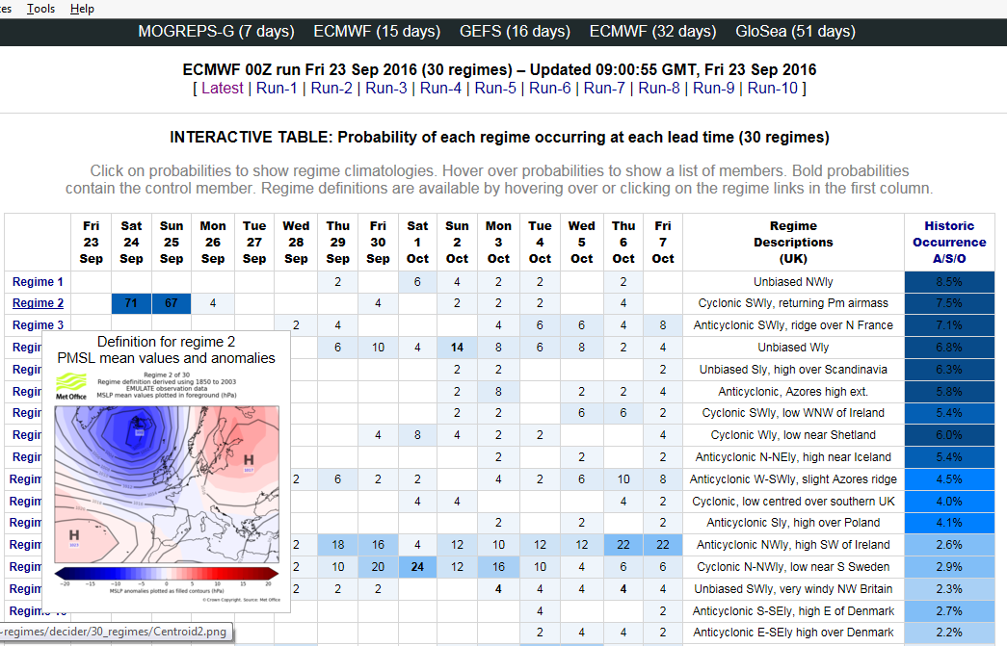
Decider – Flow regimes

Slide 38
Decider – cyclonicity and zonality

